Slide 1
Biology
Unit 6: The Structure and Function of DNA
Lesson 2: Protein Synthesis
Notes:
Lesson Objective:
Construct an explanation based on evidence for how the language of DNA is translated into the language of proteins.

Slide 2


Can You Explain It?
Unit 6 Lesson 2
How do you think a code consisting of so few characters can encode the instructions for building thousands of different proteins?

Slide 3
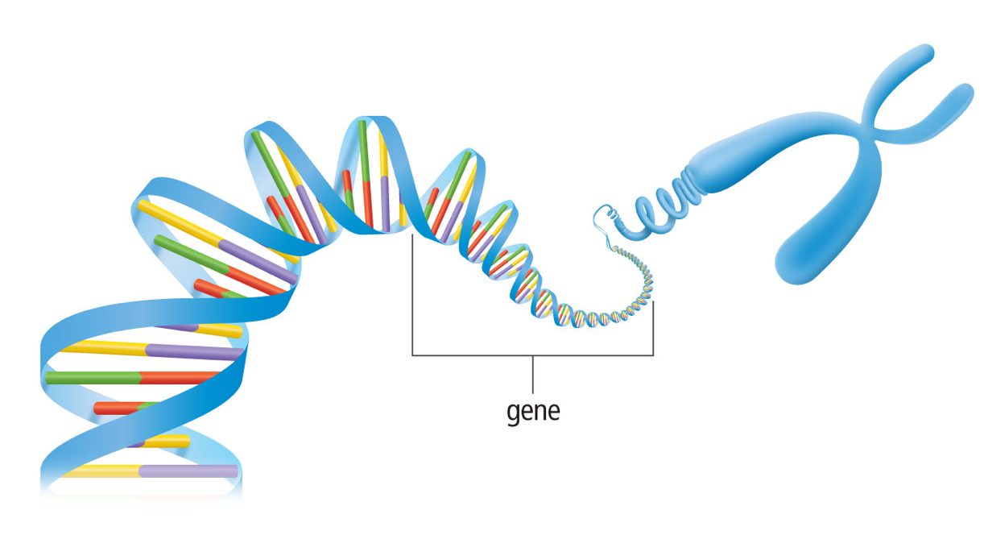
Introduction to Protein Synthesis
Unit 6 Lesson 2
Each protein is coded for by a section of DNA called a gene.
A gene is a piece of DNA that provides instructions for a cell to make a certain protein.

Slide 4
Introduction to Protein Synthesis
Unit 6 Lesson 2
EXPLAIN
Create a flow chart to illustrate the flow of information in both protein synthesis and DNA replication

Slide 5
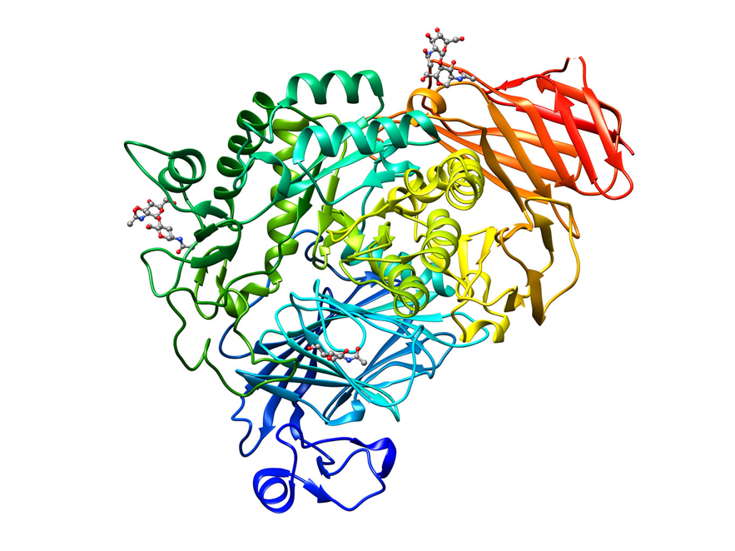
Introduction to Protein Synthesis Structure and Function
Unit 6 Lesson 2
The structure of maltase allows it to catalyze particular chemical reactions properly.
What types of questions could a researcher investigate using a computer model of the enzyme maltase?

Slide 6
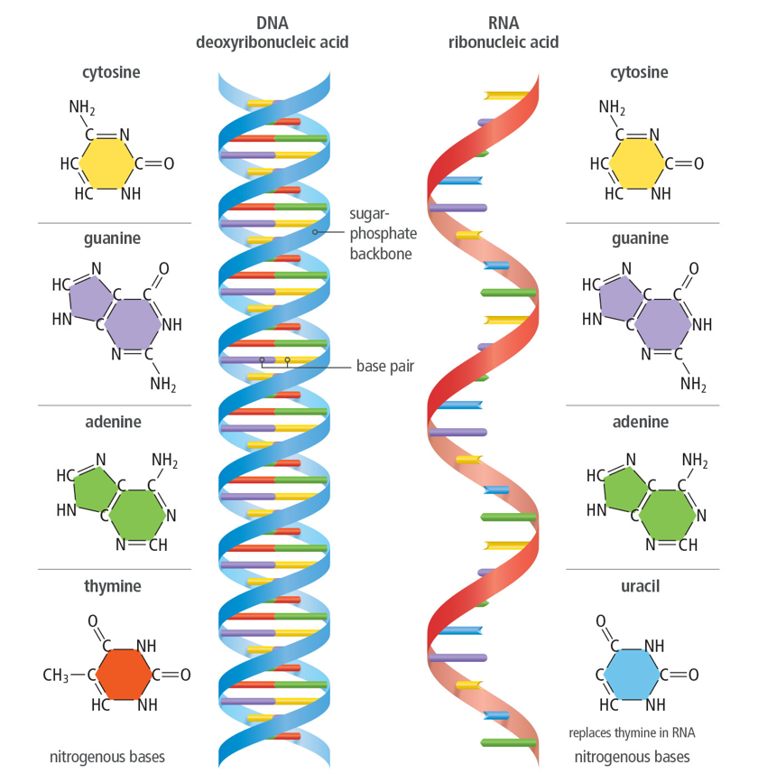
Introduction to Protein Synthesis
Unit 6 Lesson 2
RNA acts as a messenger, carrying information from DNA in the nucleus to protein synthesis in the cytoplasm.
RNA is like a temporary copy of DNA that is used and then broken down.

Slide 7
Introduction to Protein Synthesis
Unit 6 Lesson 2
EXPLAIN
Why is RNA necessary for protein synthesis?

Slide 8
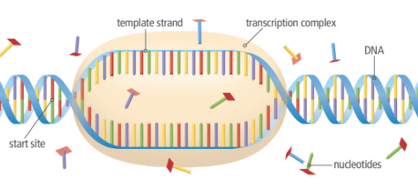
Transcription
Unit 6 Lesson 2
This first stage of protein synthesis is called transcription.
Transcription is the process of copying a sequence of DNA to produce a complementary strand of RNA.

Slide 9
Transcription Structure and Function
Unit 6 Lesson 3
During transcription, the structure of the DNA molecule determines the structure of the RNA molecule.
EXPLAIN
Explain how the structure of the DNA molecule determines the structure of an RNA molecule during transcription.

Slide 10
Transcription
Unit 6 Lesson 2
EXPLAIN
Transcription and DNA replication are often compared to one another, because they have many similarities. However, they do not have the same functions. Make a graphic organizer to compare and contrast DNA replication and transcription in terms of their functions, inputs, and final products.

Slide 11
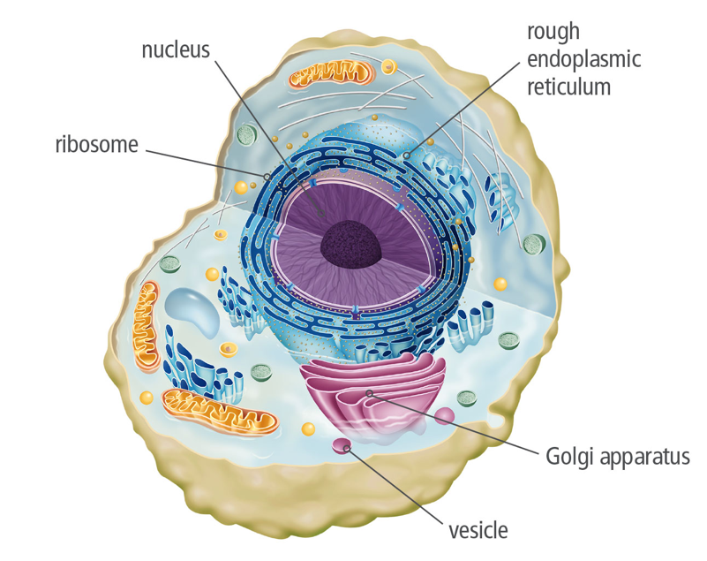
Translation
Unit 6 Lesson 2
Once the RNA is processed and leaves the nucleus through pores, it enters the cytoplasm. This is where the process of translation decodes the mRNA to produce a protein.
Once it is in the cytoplasm, the mRNA binds to organelles called ribosomes, which are made of rRNA and proteins.

Slide 12
Translation
Unit 6 Lesson 2
MODEL
Draw a flow chart to show the flow of RNA and proteins through the cell during protein synthesis.

Slide 13
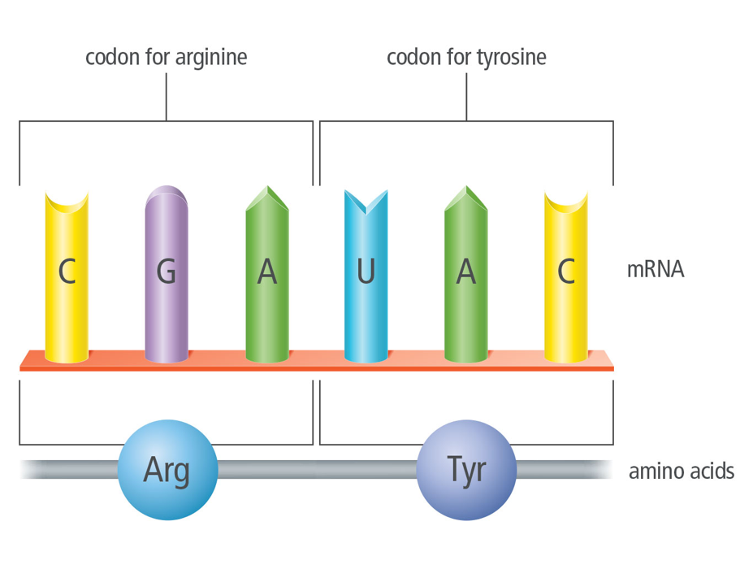
Translation
Unit 6 Lesson 2
A codon is a three-nucleotide mRNA sequence that codes for an amino acid.
Amino acids are the subunits, or monomers, that make up polypeptides. One or more polypeptides make up a protein.

Slide 14
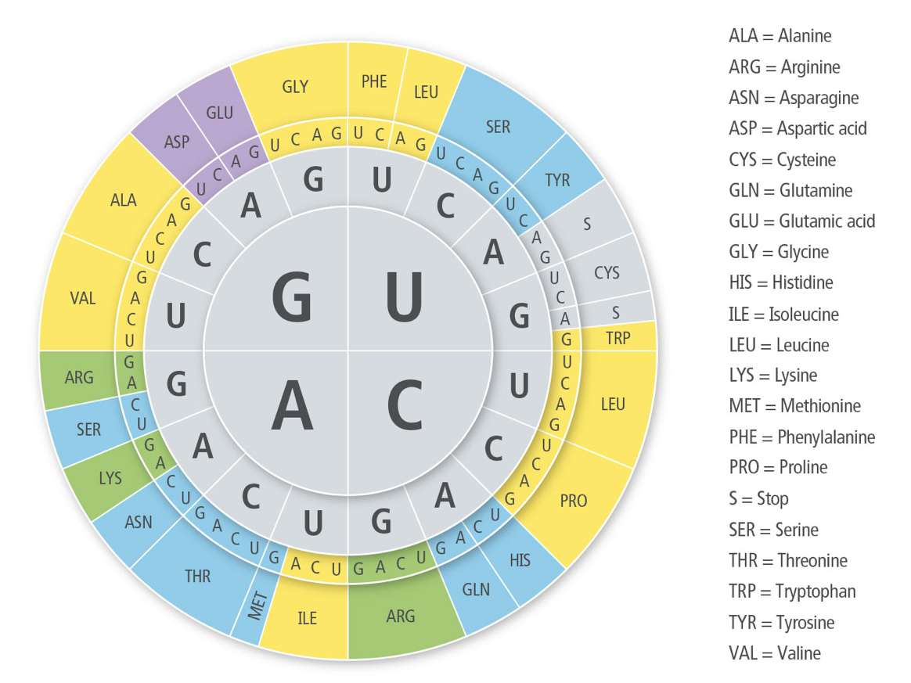
Translation
Unit 6 Lesson 2

Slide 15

Translation Hands-On Lab: Modeling Protein Synthesis and Mutations
Unit 6 Lesson 2
Model transcription and translation by analyzing a DNA sequence and writing the corresponding mRNA codons and amino acid sequence. Then, build a model of the protein and fold it into its final shape. Finally, introduce a mutation and use your model to determine how the mutation affects the protein’s structure.

Slide 16
Translation
Unit 6 Lesson 2
EXPLAIN
Summarize what you have learned so far to begin constructing an explanation for how the “language” of DNA is translated into the “language” of proteins. Construct a graphic organizer to compare the two phases of protein synthesis in terms of their function, where each process occurs in the cell, and final products.

Slide 17
Unit 6 Lesson 2
Continue Your Exploration
Choose one of the paths below to continue your exploration:
Modeling Protein Synthesis and Mutations
Explore Protein Crystallization
Making Synthetic Cells

Slide 18
Can You Explain It?
Unit 6 Lesson 2
Refer to the notes in your Evidence Notebook to answer the following questions to explain how the language of DNA is translated to the language of proteins and how this process compares to computer programming.
How does the four-letter DNA language encode instructions for making thousands of different proteins?
Which molecules act as the translators in the process of protein synthesis?
How is the process of protein synthesis similar to the process of programming a computer? How is it different?

Slide 19
Image Credits
Unit 6 Lesson 2
chromosome ©Science Source/BIOPHOTO ASSOCIATES/Getty Images; cells budding ©SPL/Science Source; bacterial cells dividing ©Science Source; onion in water ©Olena Ukhova/Shutterstock; sea stars ©Ecostock RF/Lawson Wood/age fotostock; DNA computer model Image of PDB entry 3L4V created with Chimera (http://www.rbvi.ucsf.edu/chimera/); teen students using computer ©E+/Steve Debenport/Getty Images

